Slide 1
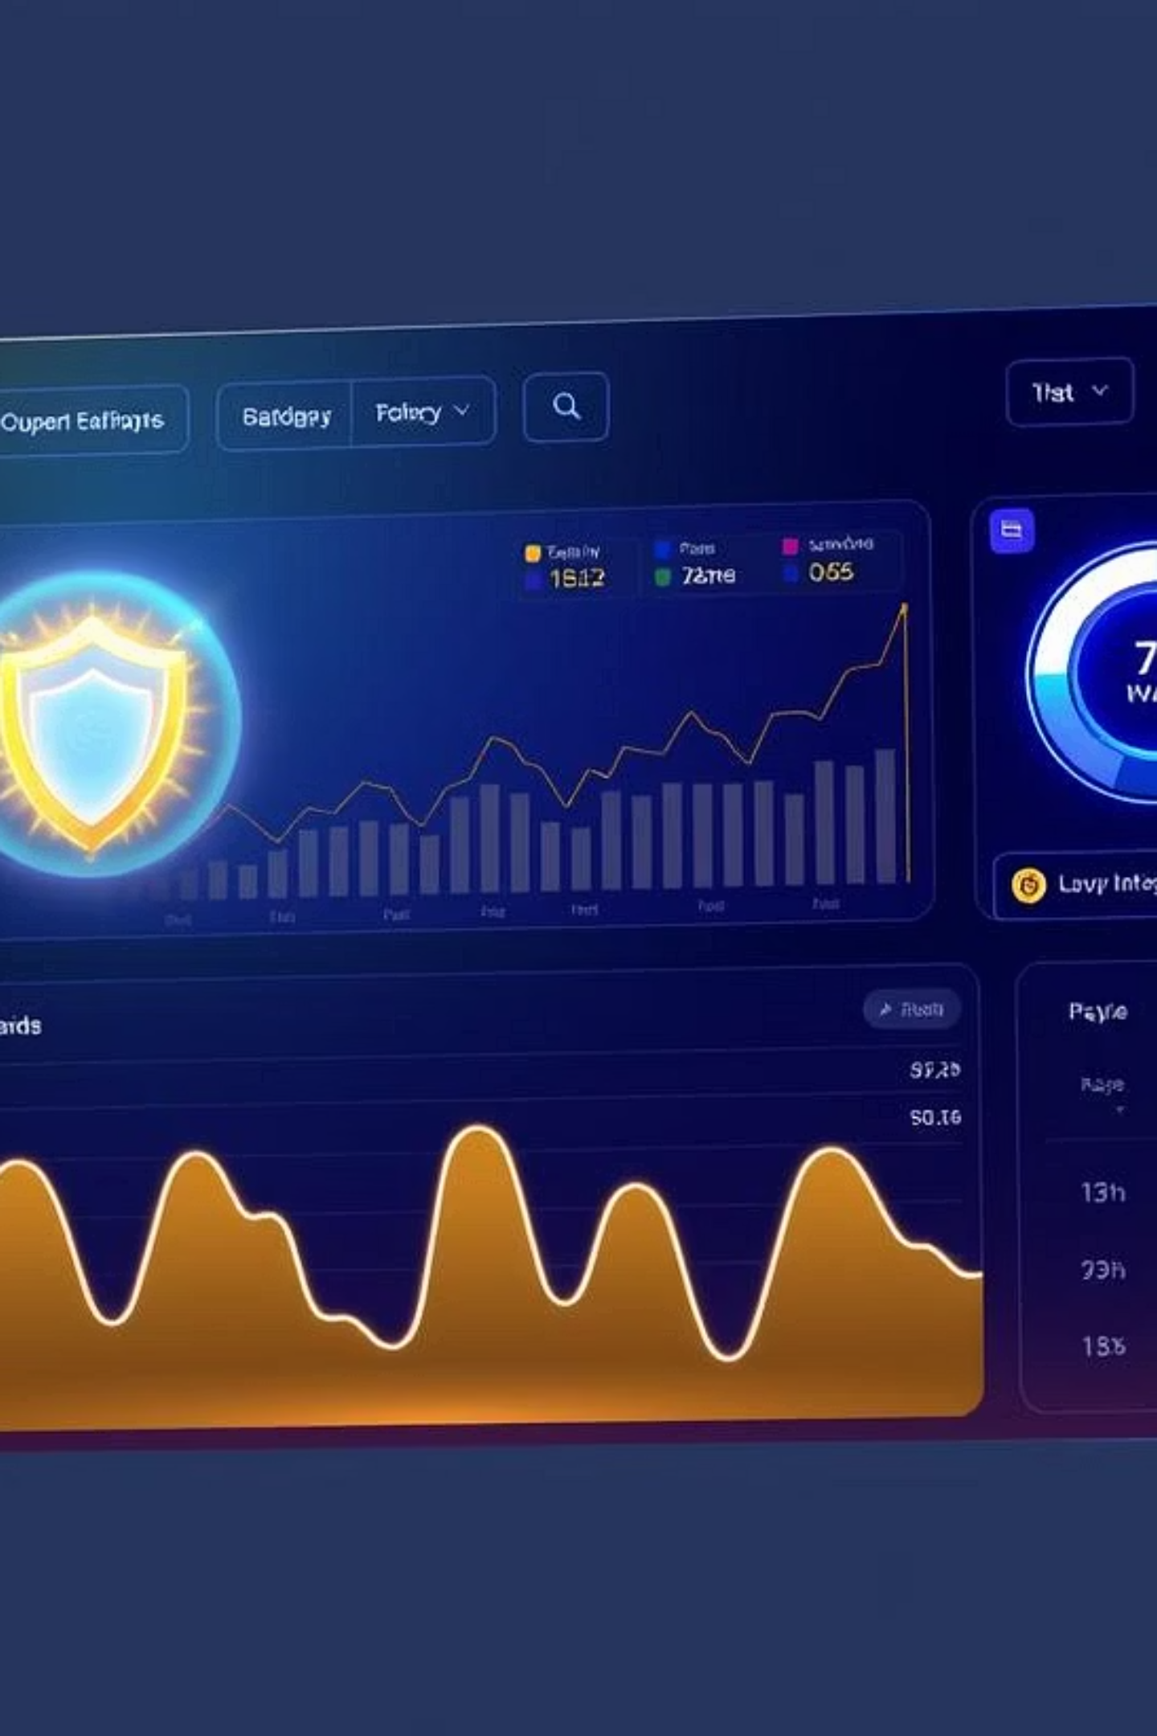
LLM-Driven ECL Analysis Chatbot for Credit Risk Management
A ChatGPT-powered system for monitoring loan portfolios, calculating Expected Credit Loss (ECL), and generating actionable recommendations.

Slide 2





Introduction and Objectives
This system uses ChatGPT to analyze loan portfolios and calculate Expected Credit Loss (ECL) based on IFRS 9 and CECL guidelines. It provides secure access, data dashboards, historical reports, and real-time chat insights.
ECL Calculations
Natural Language Interface
Secure Access
Comprehend IFRS 9/CECL-based ECL calculations.
Develop a ChatGPT interface for natural language interaction.
Ensure secure, role-based access for Analysts and CROs.
Visualize & Report
Actionable Recommendations
Display segment-level ECL curves and access historical reports.
Recommend actions based on credit risk threshold breaches.

Slide 3

Problem Statement: Bridging the Gap
Credit analysts face challenges in effectively evaluating segmented loan risk, visualizing ECL over time, and making timely decisions on interest rate adjustments or loan disbursement reductions for specific borrower groups. Our solution addresses these pain points by streamlining operations and improving efficiency.

Slide 4

Data Sources and Segmentation
Data Sources
Storage Architecture
Public loan data (similar to HMDA registers) including borrower demographics (region, gender, occupation) and loan terms.
Initial implementation uses CSV files. For production, AWS RDS or DynamoDB ensures sub-millisecond latency, automatic scaling, and data encryption.
Segmentation
Loan data grouped into statistically relevant segments based on geography, profession, gender, and credit score, following CECL/IFRS 9 best practices.

Slide 5



ECL Modeling Methodology
This formula represents the General Measurement Model for Expected Credit Loss, incorporating Probability of Default (PD), Loss Given Default (LGD), Exposure at Default (EAD), and a Discount Factor.
Stage 1
Stage 2 & 3
12-month ECL for performing loans.
Lifetime ECL for loans with significant credit deterioration or default.
Each segment's ECL curve is plotted against the time horizon, with confidence intervals and macroeconomic scenario overlays.

Slide 6
System Architecture
Microservices
LLM Service
Data API: Python/Flask
GPT-4 with Retrieval-Augmented Generation (RAG)
ECL Computation: AWS Lambda
Vector stores indexed on segment data
LLM Chat Interface: OpenAI API or LLaMA
Frontend
Auth Service: OAuth2 with JWT
React UI with user login, interactive charts, chatbot, report viewer
Data Layer
Aggregates: AWS DynamoDB
Caching & Deployment
Raw Records: AWS S3
Redis (AWS ElastiCache) for query caching
Nightly ETL pipelines
Kubernetes (EKS) and Docker for deployment
CI/CD via Terraform and GitHub Actions

Slide 7

Security and Authentication
Role-Based Access Control (RBAC)
Encryption
TLS for in-transit data, AWS KMS for data at rest.
Tiered access for Analysts and CROs, JWTs, bcrypt hashed passwords, MFA for CROs.
Compliance
PII stripped before LLM queries, private VNet for external API calls, full audit logs.

Slide 8
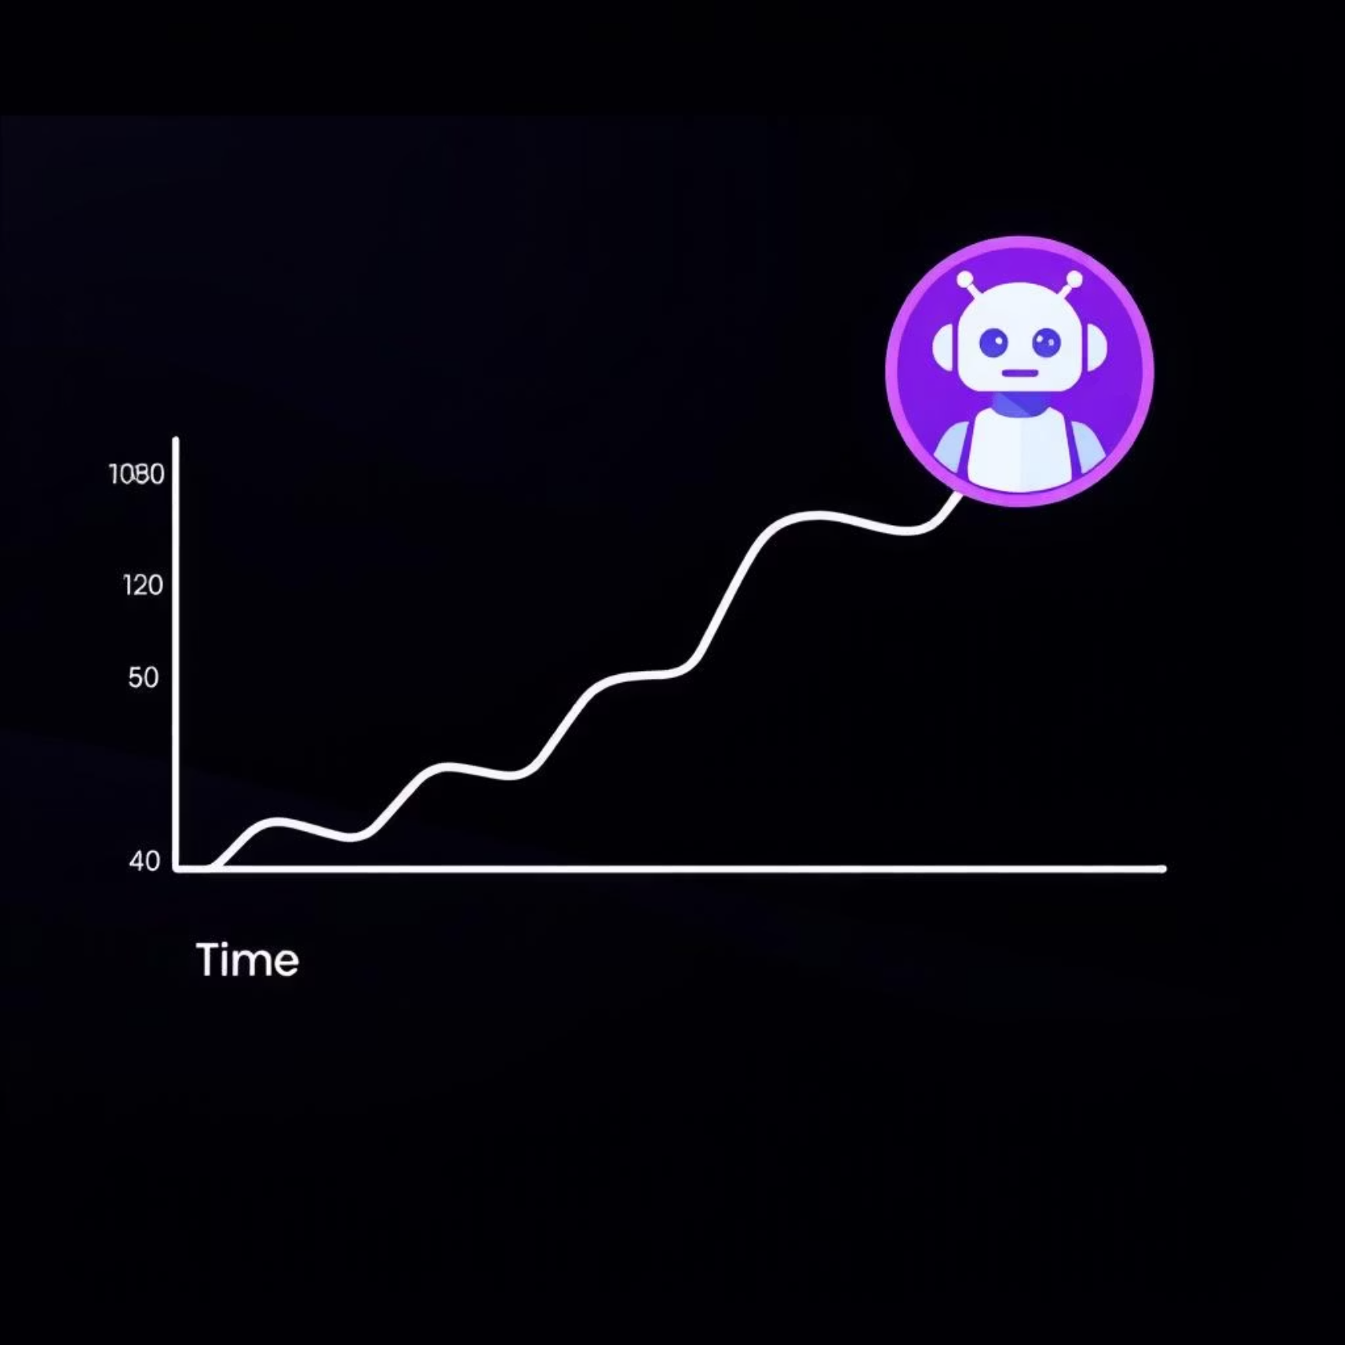
Results and Findings
ECL Curves
Performance Metrics
Urban borrowers show higher ECL trajectory than rural ones, suggesting increased credit risk in metropolitan regions.
ECL retrieval latency: ~250 ms
Full chatbot interaction: ~450 ms
Chatbot Capabilities
Users can ask questions like "What's the ECL trend for female borrowers in Region A?" Responses include visualizations and risk summaries.

Slide 9
Conclusion and Next Steps
This solution provides a scalable, secure, and intelligent platform for ECL analysis using LLMs, enhancing credit risk evaluation through automated insights and real-time visualizations.
Stress Testing
Via macroeconomic simulations and direct integration with live banking APIs.
LLM Finetuning
Further finetuning of the LLM on internal underwriting guidelines.
Advanced Explainability
XAI integration (SHAP/LIME) and bias detection (AIF360).
Dynamic Scenario Engine
Real-time macroeconomic simulations and interactive what-if sliders.
Generative Reporting
Narrative automation with GPT-4 for audit-ready summaries and anomaly alerts.
Blockchain Audit Trail
Immutable ledger for calculations and smart contracts for automated risk thresholds.

